Slide 1
James’s new restaurant
Introduction:
James, an experienced pilot and popular chef on Youtube. He has been made redundant recently due to covid-19 pandanmic.
He is certainly wealthy at this stage. Though losing his pilot job would give him more time to produce more videos on Youtube, however he wants to do something concrete and serve his audience in person with his food. So now James has an idea, which is to make use of his popularity on Youtube for his new restaurant. He believes his new restaurant can draw attentions by his food and popularity
Problem:
To satisfy his needs, he has to determine which town in Hong Kong is surrounded by crowd and type of restaurant which easily gets popular. Thus, the selection criteria can be measured by the following
1. Location: total population and population density of Districts in Hong Kong
2. Type of popular restaurants in selected District : The type of restaurant which is registered with high volume of total ratings and tips from Foursquare

Slide 2
Data requirements:
1. List of towns in HK as well as the data pertaining to Latitude/Longitude
2. Population of District
3. List of restaurants in the selected District and the data pertaining to volume of ratings and tips
Data source:
https://en.wikipedia.org/wiki/List_of_towns_in_Hong_Kong
https://en.wikipedia.org/wiki/Districts_of_Hong_Kong
Foursquare

Slide 3
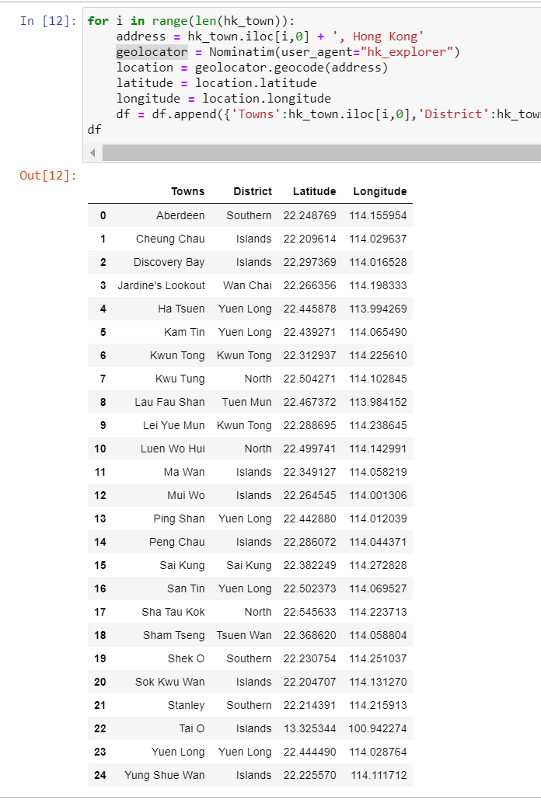
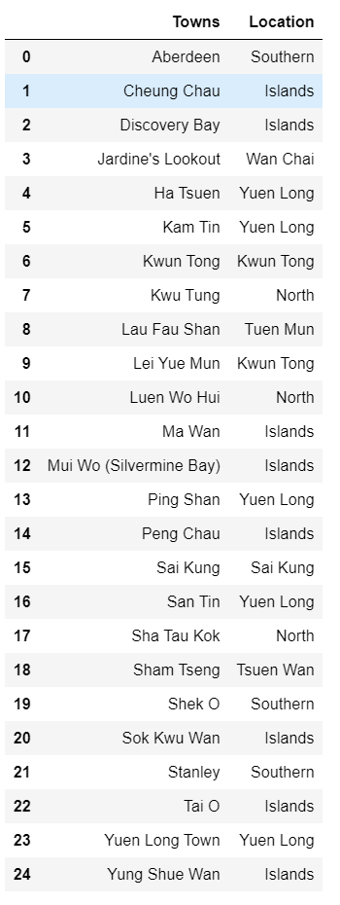
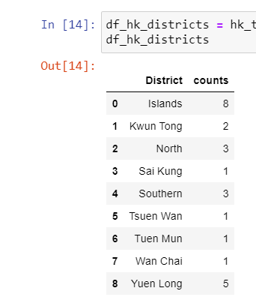
Data cleansing(1):
Towns of Mui Wo (Silvermine Bay) and Yuen Long Town are not recognized by geolocator. Thus, they are renamed to Mui Wo and Yuen Long respectively
Obtain a dataset of latitude and longitude for each town
Get a list of District

Slide 4
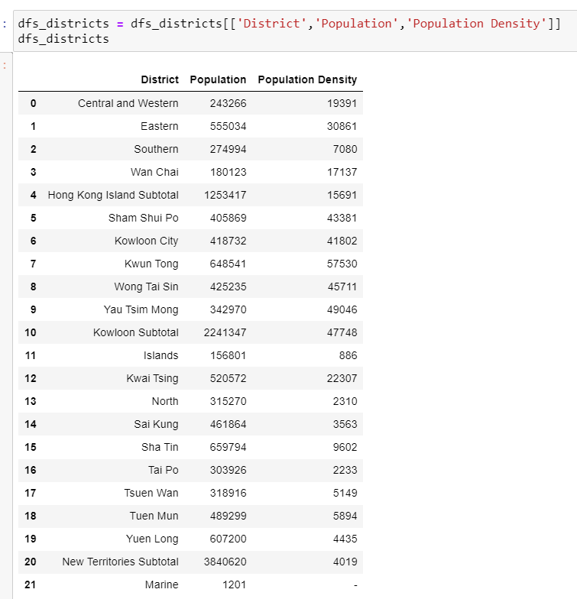
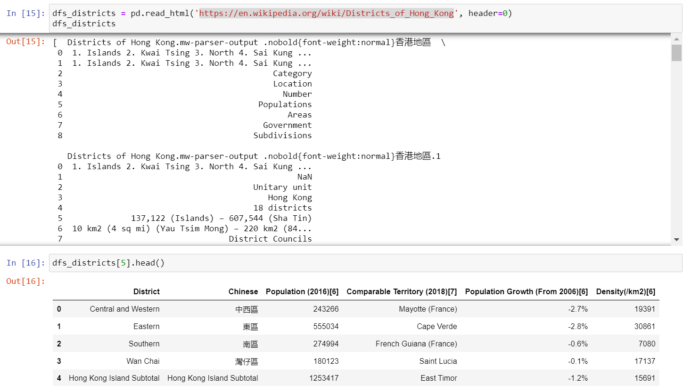
Data cleansing(2):
Rename two columns to Population and Population Density before merging with list of District

Slide 5

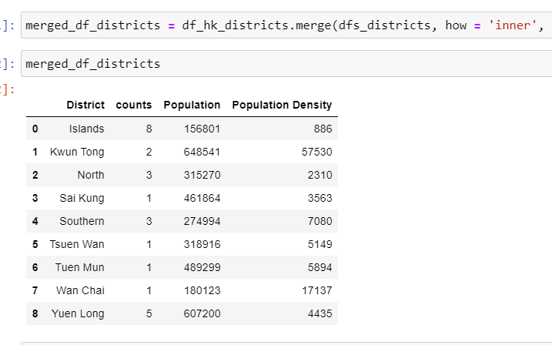
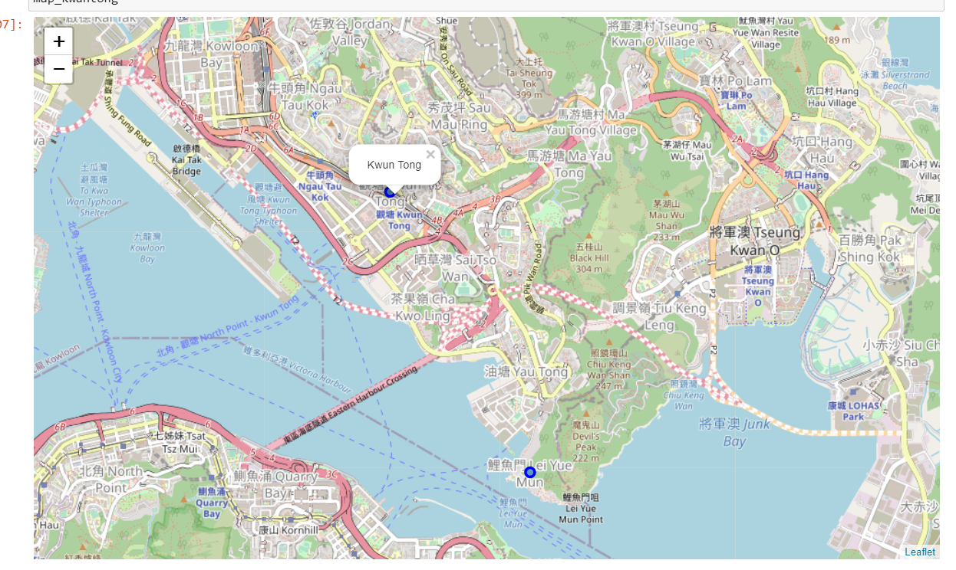
Exploratory Data Analysis:
Then merge with list of District to figure out which District has the highest population and population density
Kwun Tong have the second highest population, and first in population density
Kwun Tong Town is surrounded by both residential and commercial area which provide good supply of population to Jame’s restaurant than Lei Yue Mun which is located along the coastline

Slide 6
Final data information before ML model
Kwun Tong town is selected (Latitude = 22.312937 and longitude=114.225610)
50 restaurants are found within 400m of Kwun Tong Town from Foursquares with Search function
39 restaurants are explored with Ratings and Tip counts from Foursquares
39 restaurants with their ratings and tip counts will be processed with Kmeans model for clustering

Slide 7
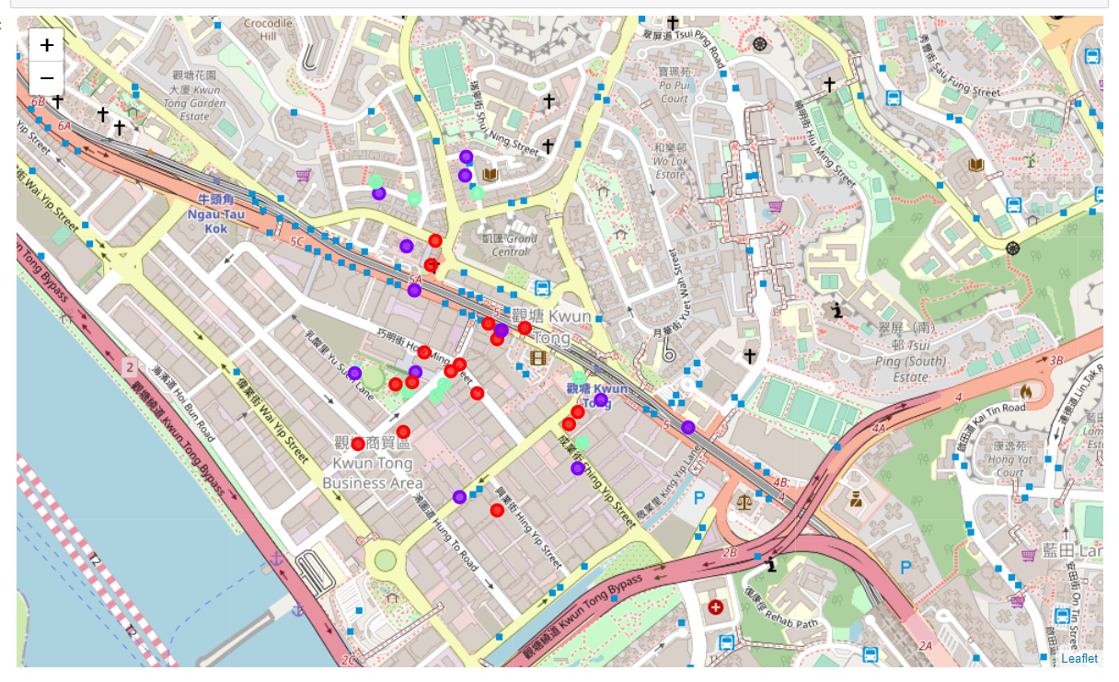
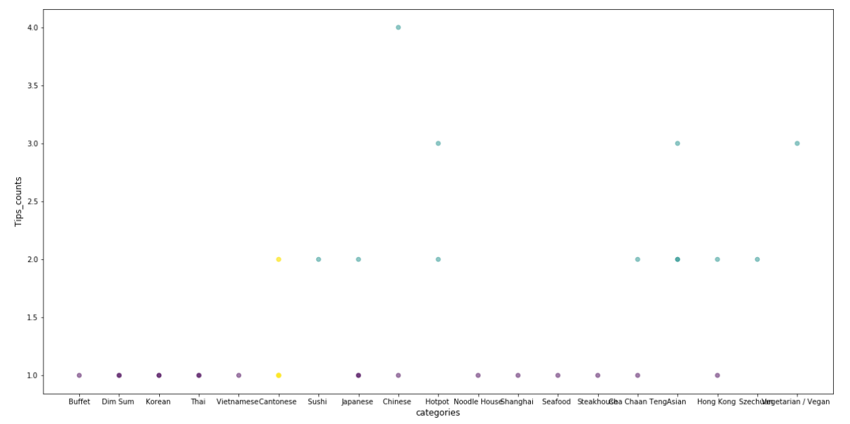
Result from ML model (Kmeans)
Total of 39 restaurants among 19 types of restaurants in Kwun Tong town
3 clusters to be classified in Kmeans model
1st cluster is the restaurants with only 1 tips count, their categories is mainly one specific cuisine. Example, Thai, Japanese and steakhouse etc
2nd cluster is the restaurants with at least 2 tips counts (range of 2 to 4). Chinese restaurant has the highest tip counts (4), and followed by Asian/hotpot/vegetarian restaurants which has 3 tips count
3rd cluster is the restaurants with 1 or 2 tips counts, and they all Cantonese restaurants
1st cluster
2nd cluster
3rd cluster
Observation from the map:
Location of the restaurant does not seems a factor to tips count restaurants in same cluster are still scattered everywhere

Slide 8
Conclusion:
According to the data insight and result from Kmean model, we can draw the following conclusions which shall answer Jame's questions i.e Location and type of his restaurant
Jame’s restaurant shall be located in Kwun Tong District in which his restaurant will be exposed to the 2nd highest population and 1st highest population density of district in Hong Kong
Town of Kwun Tong is surrounded by both residential and commercial buildings which are good supply of crowds hence it is helpful to increase popularity i.e tips count
Among all categories of restaurant, Asian/Chinese/Hotpot restaurants tends to draw more attention than other restaurants serves one specific type of cuisine such as Cantonese restaurant, Japanese restaurant or Thai restaurant etc. Perhaps the like of people for restaurant is the variety of food to choose in restaurant menu

